Slide 1
Web Page Creation
Online platform: Weebly

Slide 2
Objectives
At the end of the lesson, the students should be able to
know the importance of website,
sign up to an account in Weebly.com,
create the main page of a website using an online tool (Weebly) with creativity,
publish the created website.

Slide 3
What is a Website
a collection of Web pages, images, videos or other digital assets that is hosted on one or several Web server(s)1, usually accessible via the Internet, cell phone or a local area network (LAN)2
A document, typically written in hyper text mark-up language (HTML)3, which is almost always accessible via hypertext transfer protocol (HTTP4)

Slide 4
4 Components that you need to consider
domain name (what you call your website)
.com (for commercial)
.edu (for educational)
.net (for network)
Web host (puts your website on the internet)
Ex.: ipage.com, namecheap.com, justhost.com, web.com, GoDaddy.com, HostGator.com, others

Slide 5
4 Components that you need to consider
Website building software (installs your website on the internet)
Topic (refers to the content you wish to be published such as classroom-related, personal, business, etc.)

Slide 6
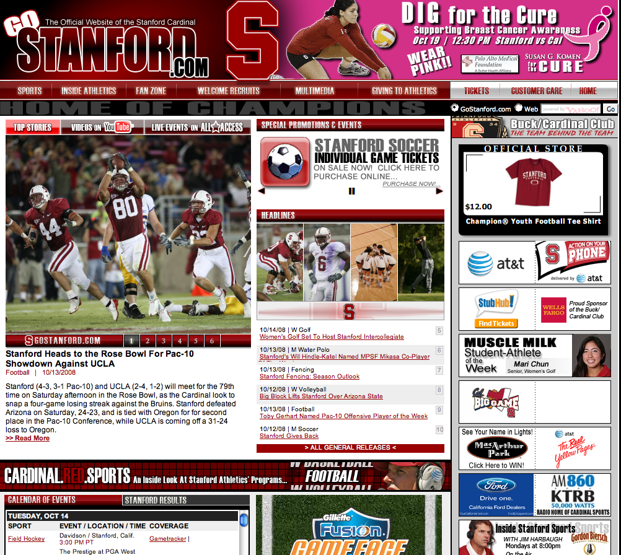
The Making of a Good Design
Content is important, but content alone will not make your site work.
Notes:
Biggest mistake in web design is to build a site for the designer, not the user.
Users expect sites to be flawless.
Looks matter. Site should be pleasing to the eye. Site should evoke trust and value.

Slide 7
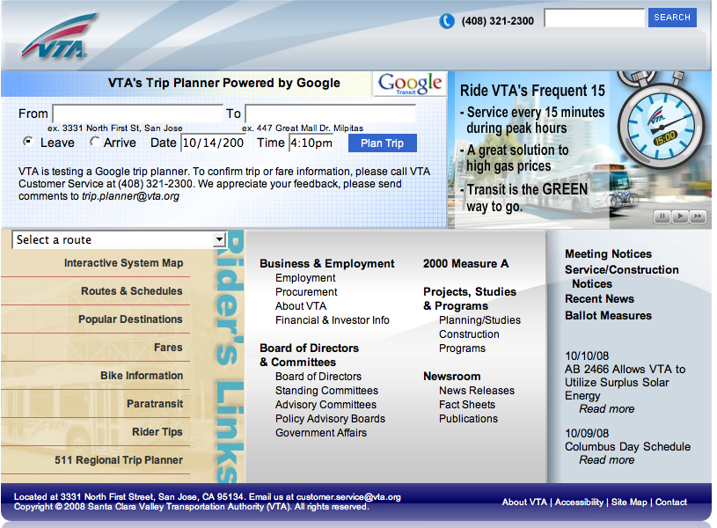
The Making of a Good Design
Content is important, but content alone will not make your site work.
Good Design is:
Understandable
Interesting
Easy to use
Uniform in look and feel
Done from a visitor’s point of view:
WYSIWYW (What You See Is What You WANT)
web.stanford.edu/group/csp/cs21/webdesign.ppt
Notes:
Biggest mistake in web design is to build a site for the designer, not the user.
Users expect sites to be flawless.
Looks matter. Site should be pleasing to the eye. Site should evoke trust and value.

Slide 8
In designing your website, consider the following:
Decide What Type of Website You're Having,
Define your Target Audience
Choose Your Content
Easy to search
Use a clean design, simple navigations, use larger fonts and always have white spaces
Build a responsive site

Slide 9
Importance of creating a website for your classroom
It is one of the many initiatives in integrating ICT in the classroom
It is a fact that students today are electronically connected
Study shows that classroom or educational websites offer positive pedagogical and social benefits in the academe
Educational websites help make the process of learning entertaining and attractive to the student

Slide 10
Benefits of having a website in your classroom
Students will have access to a learning space that is open to them whenever and wherever they are,
Students can use it to check class assignments, important dates, schedules, school events, announcements and many more,
Website encourages students to connect the learning that is taking place inside the classroom with the one in the virtual space by adding postings, media materials (including images, videos, audio clips...etc),
Students can also use websites to collaborate and work together on classroom projects,
Website is also a good way to engage parents and make them part of the learning process of their kids, and
Parents can stay updated about where their kids are in their learning, see their grades, and they can even volunteer in sharing extra resources.
Taken from Educatorstechnology.com

Slide 11
WEBSITE CONTENT
“Content can make a Website attractive to a visitor”. ~ Sivasubramanian, 2000 suggested the following Key points:
be disciplined
update your site regularly, and
know how to create content, or where to find it

Slide 12
WEBSITE CONTENT
According to Matt Cutts of Google:
“Have a well-rounded site: great content has to be the foundation of any good site because mediocre content tends not to attract exceptional links by itself, and if you’re trying to get exceptional links to crappy content, you’re going to be pushing uphill. It’s much better to have great content that gets those links naturally. Rather than having something that’s not that interesting and trying to push, push, push and bug people and send out spam emails asking for links and those sorts of things. So a well-rounded site has interesting, useful content, great resources, great information and that naturally attracts links.”

Slide 13
WEBSITE CONTENT
Heijmans (2012) suggests that a website must have an introductory content that comes in two forms:
The right slogan or tagline as introductory content
Adding a few paragraphs as an introduction.

Slide 14
Some Good Tips to Consider
Factors that affect readability
Poor eyesight of users
Smaller, older computer monitors as displays
Poor color perception of users
“Cocktail-party” effect -- lots of information on a single web page
Design fixes:
Use high contrast between text and background
Use lots of white space
Use larger fonts
Put key navigation buttons in the upper left
Don’t rely on color alone to distinguish between elements on a web page
Avoid busy graphics
Limit page noise -- ensure page elements don’t compete for a visitor’s attention
web.stanford.edu/group/csp/cs21/webdesign.ppt
Notes:
Upwards of 20% of all men are color blind. Always use something other than color to distinguish elements on a web page.

Slide 15
Some Good Tips to Consider
Don’t force visitors to remember how to navigate/use the site
Provide redundant, easily recognizable features
Generally, have visited and unvisited links be different colors to make it easy for users to remember where they’ve been
Limit the number of items in a group of choices
web.stanford.edu/group/csp/cs21/webdesign.ppt

Slide 16
Some Good Tips to Consider
Poor reasons:
To look cool
To prove you can
Good reasons:
To look cool!
To draw attention
To maintain attention
To enhance information
To inform or educate
web.stanford.edu/group/csp/cs21/webdesign.ppt

Slide 17
Some Good Tips to Consider
Make the navigation clear and simple
Use a clean visual layout with ample white space
Use descriptive link texts (avoid using “click here” without more information)
Provide text equivalents for non-text elements
Don’t rely solely on color to indicate links
Don’t make the screen flicker
Use plain, understandable English
Don’t rely completely on high-tech solutions
Don’t use header tags for visual formatting
Add "skip to" links to main navigation and page content
If PDF files are used, provide alternate formats for the information
web.stanford.edu/group/csp/cs21/webdesign.ppt
Notes:
Best practices:
1) navigation is clear and consistent
2) clean visual layout & use of white space
3) CSS for visual formatting
4) Alt attributes for images
5) Header tags in their proper hierarchy (not for visual formatting)
6) flexible screen & font sizes
7) descriptive link text (not click here)
8) structural, not visual markup (strong not bold; em not i)
9) summary sentence at the top of each page
10) "skip to" links to main navigation and page content
11) PDFs - provide alternate formats
12) Audio/video - provide link to transcript

Slide 18
Some Good Tips to Consider
Set a maintenance schedule for the site.
Who will do the maintenance?
What to do if emergency problems occur?
Where will backup copies of the site be located?
Schedule a quarterly review of the site.
Does the content need updating?
Is the design still working?
Are there newer, cutting-edge tools we should be using?
web.stanford.edu/group/csp/cs21/webdesign.ppt

Slide 19
Webpage Building

Slide 20
Common educational website creation tools
Google Sites (https://www.google.com/webdesigner/)
Weebly for Education (www.weebly.com)
School Rack (http://www.schoolrack.com/)
Webs (http://www.webs.com/)
Taken from Educatorstechnology.com

Slide 21
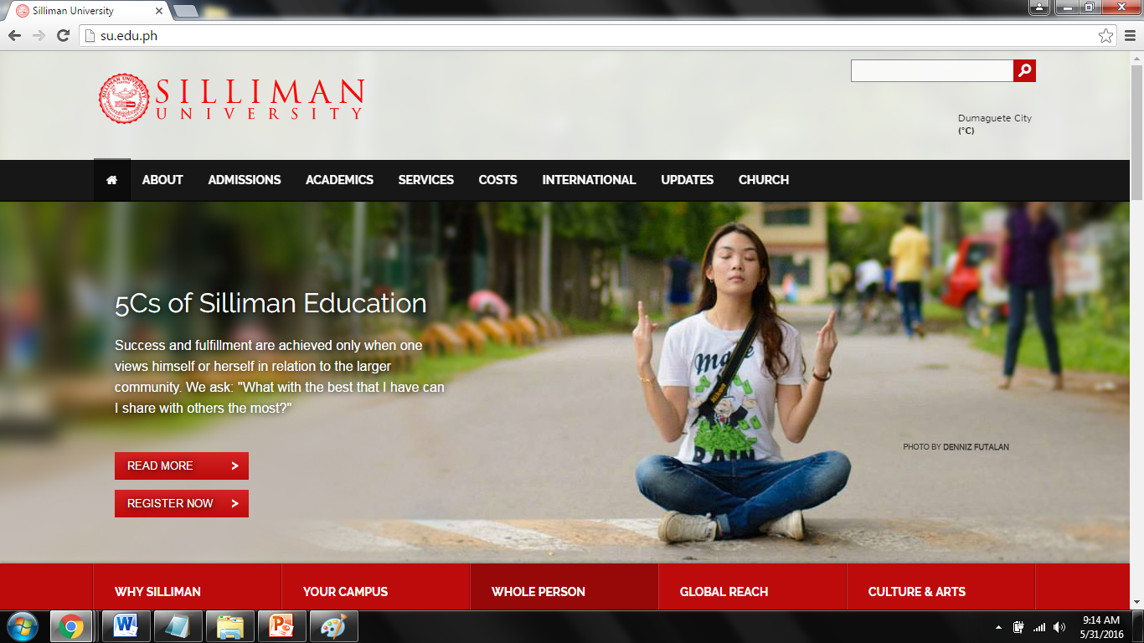

Slide 22
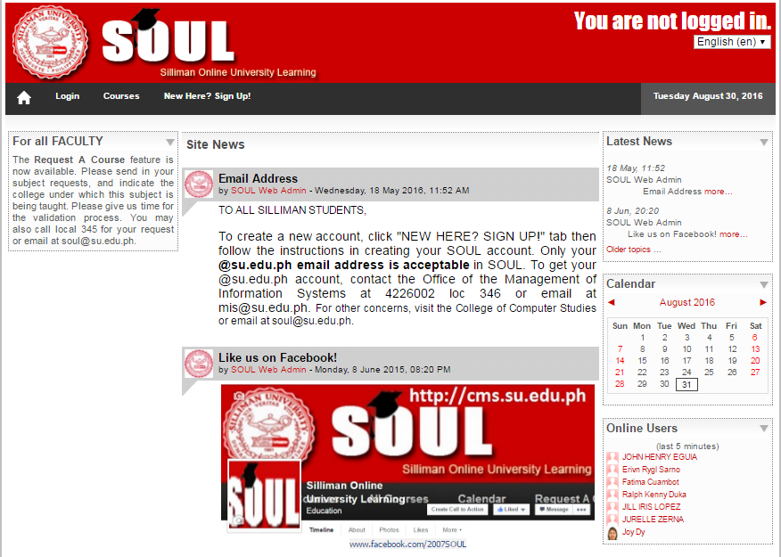

Slide 23
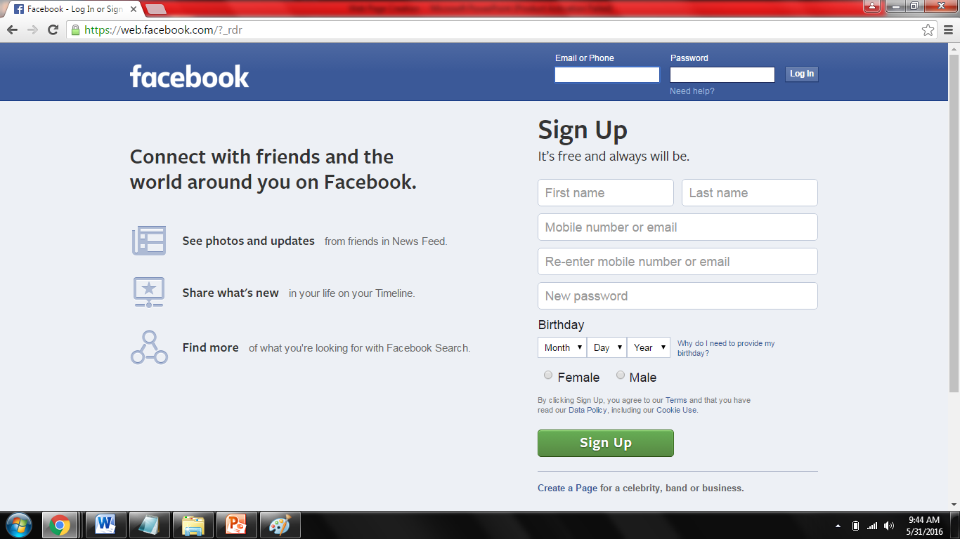

Slide 24
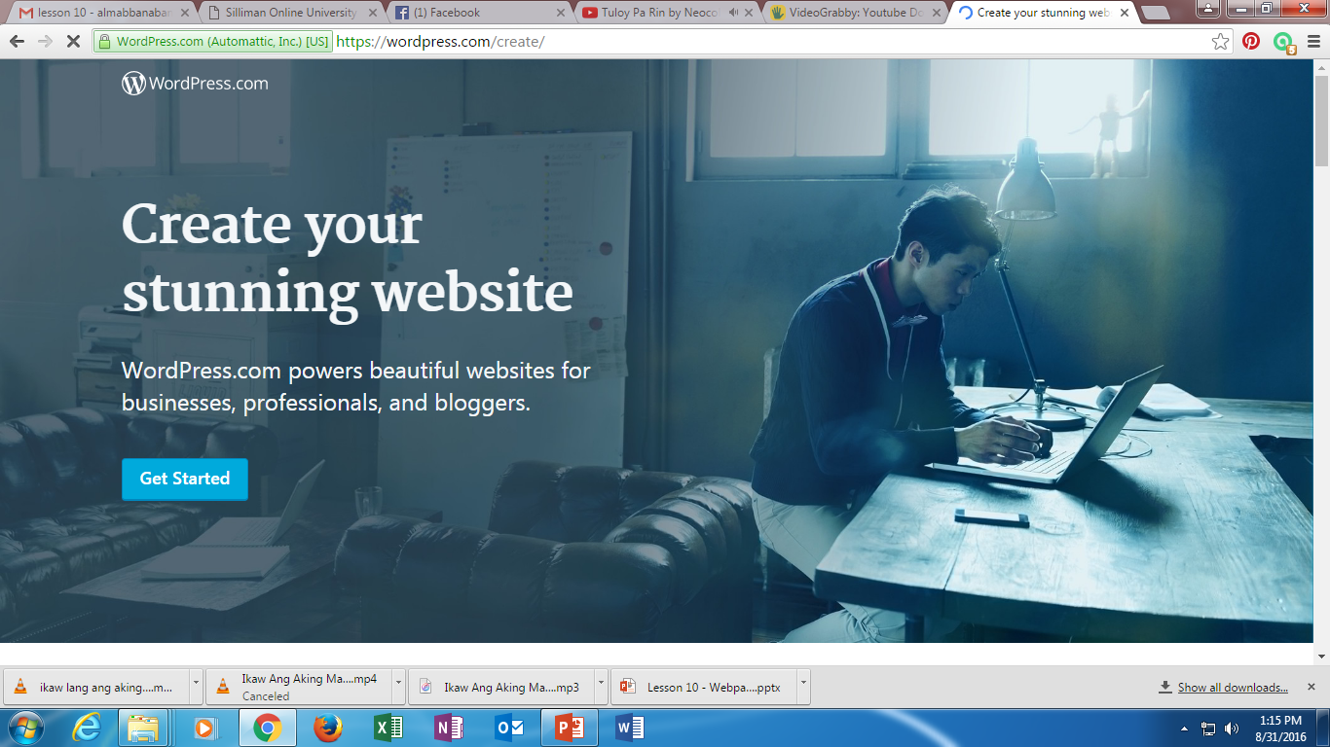

Slide 25
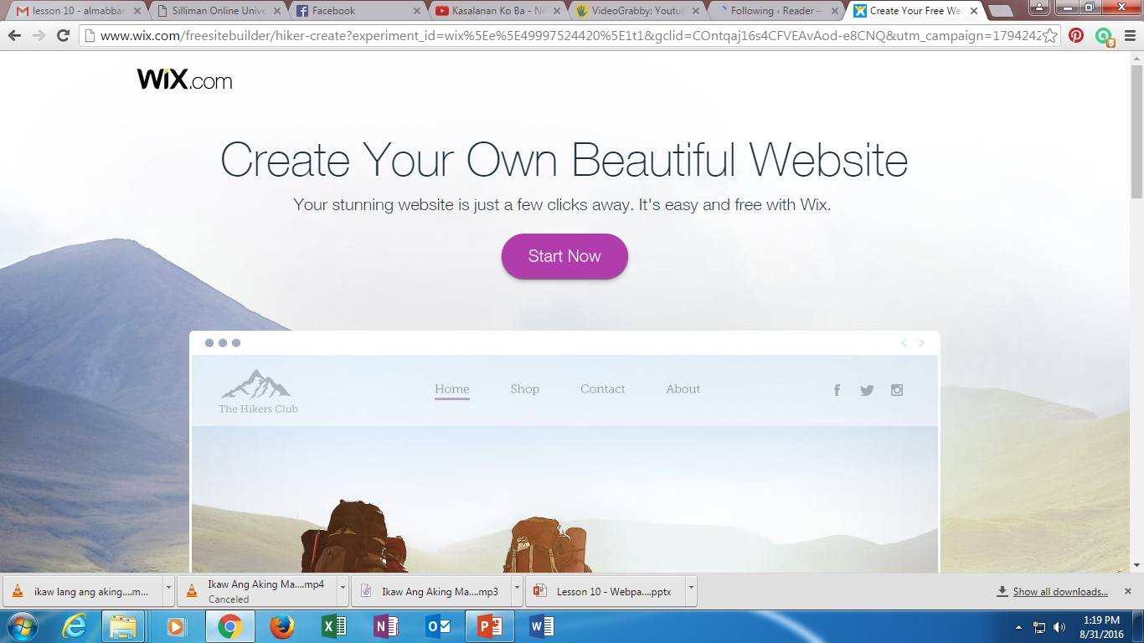

Slide 26
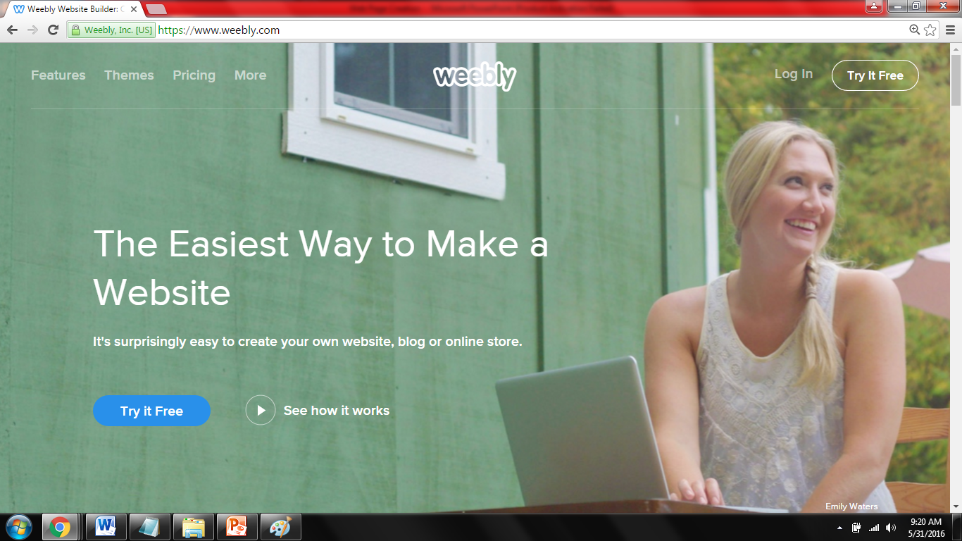
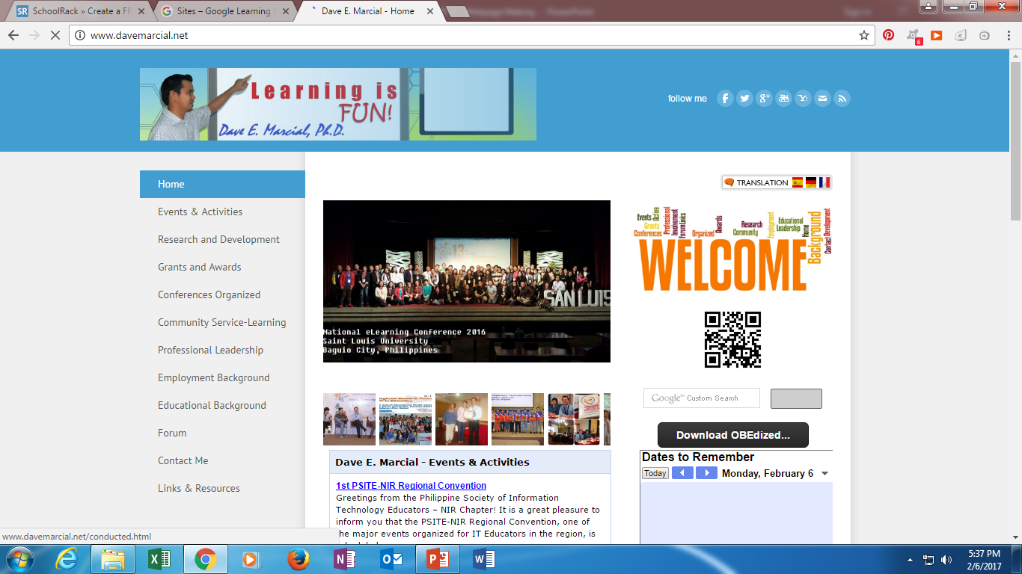

Slide 28
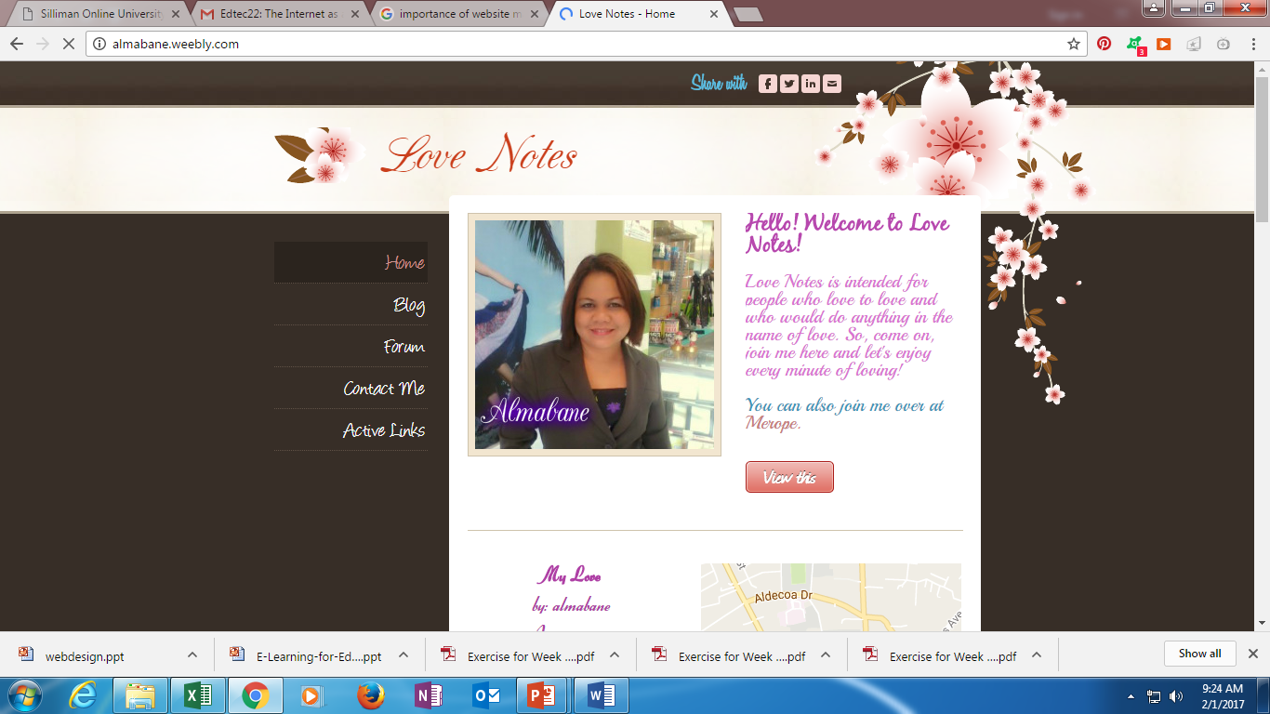

Slide 29
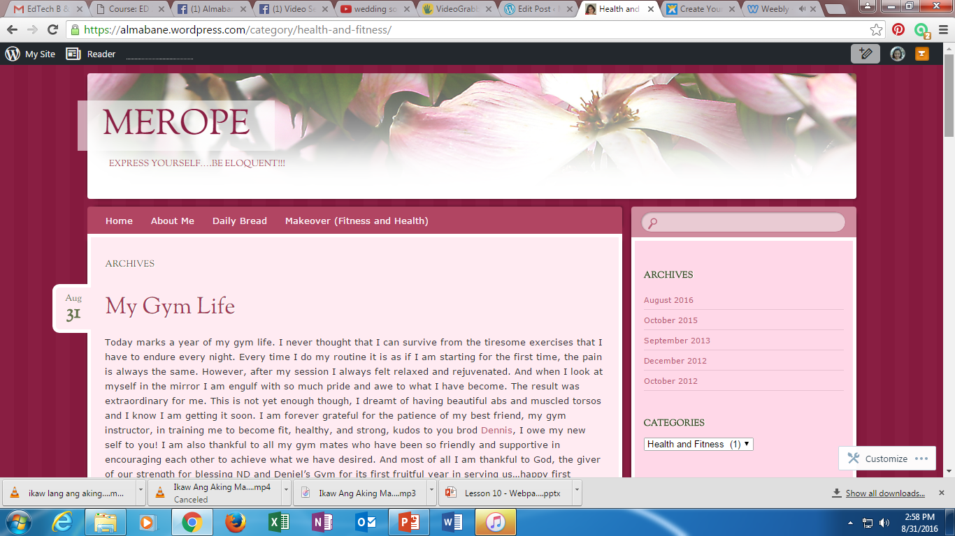

Slide 30
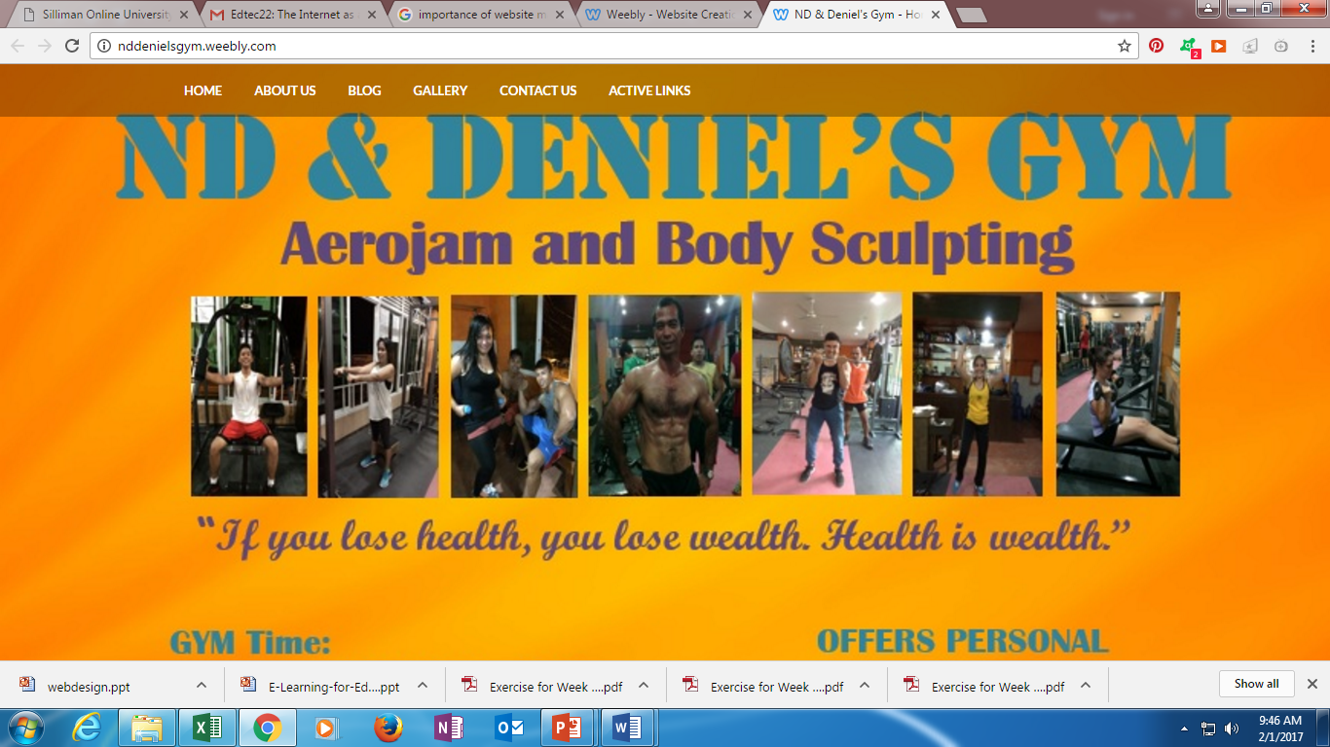

Slide 31
WYSIWYG Website Builders
WYSIWYG is an acronym that stands for What You See Is What You Get. This type of pre-programmed web design applications are named so because whatever is typed will show up exactly as it is on the finished website. There is no need to learn coding and type in lines and lines of codes to achieve anything. The templates are all readymade and can be modified by simple methods.

Slide 32
Advantages of Website Builders
Using the WYSIWYG Website Builders has manifold advantages. Here we have listed down a few of them, to help you understand the benefits of depending on these website building applications.
These are easy, do-it-yourself website creating methods. Anybody with basic internet and computer skills can design a professional looking website using these readymade template designs. No longer do you have to depend on professional coders or website developers in case you want to create the perfect website for your business.
For those of you with dynamic websites such as a blog or an article directory, WYSIWYG editors are the way to go. External users can also easily use these editors to easily enter and modify their content, leading to better and more effective online interaction and participation.
Editing and modifying your existing website with the help of WYSIWYG is a simple task. Forget depending on professionals, now you can modify your website content and design as and when you see the need.
The process of creating a website with the help of WYSIWYG editors is so much faster than depending on elaborate codes. Even if you do have a coder or a programmer at your disposal, the entire process is so much more cumbersome and takes much more time than with these WYSIWYG editors.

Slide 33
WYSIWYG vs. HTML
WYSIWYG
HTML
Incidental Webmasters
Professional Webmasters
Web Programmers

Slide 34
Steps in website creation
Create an account or log in to an existing account.
www.weebly.com
Fill out name, email, and password
Try It Free
Sign Up

Slide 35
Steps in website creation
Choose a theme.
Choose a website domain.
Start customizing.
Publish the website.
Access the website.

Slide 36
Difference among CV, Resume and Bio Data
Add a page
Click on the Pages menu.
Click on the “+” sign on the upper left part of the page.
Choose the kin of page you want to add.

Slide 37
Activity: Educational/Personal Website
Each student must develop a website using any free website builder like Weebly (www.weebly.com ).
The website must be related to your major field of specialization.
The website must contain the following basic and multimedia elements:
Tagline/slogan with an introductory paragraph at the Home page
Paragraph with picture
Paragraph
Button (must include a button that will direct to www.su.edu.ph)
Photo gallery
Slideshow
File hyperlink
Google map of your address
YouTube (embed the YouTube address of a video about your major)
Layout (multiple and divided)
Link (add a link to SOUL at cms.su.edu.ph)
Bullet (button)
Bullet (number)
Creative graphics and design

Slide 38
Activity: Educational/Personal Website
The website must contain at least 5 pages (including “Blog”, “Teaching Materials”, and “Contact”). 1 page must contain at least 2 sub-pages in different layouts.
The website must have a page for “Blog”. Post at least 1 blog about your experiences in developing your website.
There must be at least 2 comments from the blog posted. So tell your classmates/friends to post comments on your blog.
The website must have a page for “Contact”. This page is intended for online submission of comments, suggestions, inquiries and others. “Contact” form must require name, address, email address and comment. The “Contact”page must have subpages for your favorite website (which must be related to your major) and at least 3 websites of your classmates.
Publish the website. Share the website link to your Facebook and tag me (Almabane Banot). Deadline: February 28, 2017 @ 10:00pm, Tuesday.

